Slide 1

Business Continuity Planning and Disaster Recovery

Slide 2
Agenda
BCP vs. DRP
Common Terms
Roles and Responsibilities
Summary BCP Sub-Plans
7 Phases of BCP
Additional Frameworks

Slide 3
BCP vs. DRP
Business Continuity Planning: Focuses on sustaining operations and protecting the viability of the business following a disaster, until normal business conditions can be restored. The BCP is an “umbrella” term that includes many other plans including the DRP. Long Term focused
Disaster Recovery Planning: goal is to minimize the effects of a disaster and to take the necessary steps to ensure that the resources, personnel and business processes are able to resume operations in a timely manner. Deals with the immediate aftermath of the disaster, and is often IT focused. Short Term focused
Notes:
Often these terms are used interchangeably in the field, however they are distinctly different. The BCP is a large scale plan geared towards sustaining the organization after a disaster. The BCP looks at all the business processes within an organization and provides information on how to restore operations for each process.
The Disaster Recovery Plan, on the other hand, is simply one of eight sub-plans of the BCP and is usually IT focused.

Slide 4

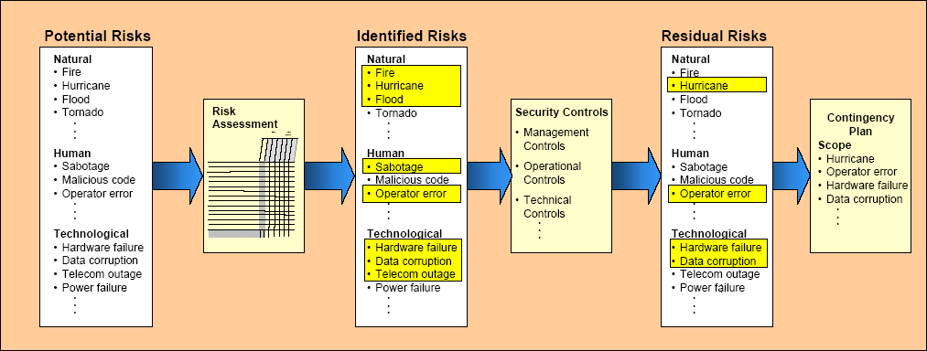
Notes:
In Chapter 1, Information Security and Risk Management, we looked at Risk Management. Risk Management deals with Identifying, Assessing, Analyzing and Mitigating risks to a level acceptable by management. Notice, the definition says nothing about eliminating risks, because it’s simply not possible. In most cases, the best we can do is to mitigate them. With risk mitigation, we are lessening the probability and/or impact of a risk event. However, as you’ll remember, the amount of risk that’s left after a risk response is called residual risk. Business Continuity Planning and Disaster Recovery Planning are all about what to do when our mitigation strategies fail, or with that residual risk

Slide 5
Mitigate Risks
Reduce negative effects:
– Life Safety is the number 1 priority!
– Reputation: Is the second most important asset of an organization. Though specific systems are certainly essential, don’t forget to focus on the big picture—protect the company as a whole

Slide 6
Business Continuity Planning
Disaster recovery and continuity planning deal with uncertainty and chance
  Must identify all possible threats and estimate possible damage
  Develop viable alternatives
Threat Types:
  Man-made
    Strikes, riots, fires, terrorism, hackers, vandals
  Natural
    Tornado, flood, earthquake
  Technical
    Power outage, device failure, loss of a T1 line
Notes:
Possible Threats
Disaster recovery and continuity planning deals with uncertainty and chance. The point of making these plans is to try and think of all the possible disasters that could take place, estimate the potential damage and loss, and develop viable alternatives in case those events do actually take place. Risk assessment and analysis need to be performed to evaluate all potential threats.
Threats can be man-made, natural, or technical. A man-made threat may be an arsonist, a terrorist, or simple mistakes that can have serious outcomes. Natural threats can be tornados, floods, hurricanes, or earthquakes. Technical threats can be data corruption, loss of power, device failure, or loss of a T1 line. It is important to identify all possible threats and estimate the probability of them happening. Some issues may not come to mind when developing these plans, like an employee strike, vandals, disgruntled employees, or hackers.
These issues are best addressed in a group with scenario-based exercises. This ensures that if a threat became true, the plan includes the ramifications on all business tasks, departments, and critical operations. The more issues that are thought of, the better prepared a company can be when these events actually take place.

Slide 7
Business Continuity Planning
Categories of Disruptions
  Non-disaster
    Disruption of service
    Device malfunction
  Emergency/Crisis
    Urgent, immediate event where there is the potential for loss of life or property
  Disaster
    Entire facility unusable for a day or longer
  Catastrophe
    Destroys facility
  A company should understand and be prepared for each category
ANYONE CAN DECLARE AN EMERGENCY, ONLY THE BCP COORDINATOR CAN DECLARE A DISASTER
  Anyone can pull the fire alarm or trigger an emergency alarm. Only the BCP coordinator or someone specified in the BCP can declare a disaster which will then trigger failover to another facility
Notes:
Categories of Disruptions
There are four main categories of disruptions; they are usually classified as non-disasters, emergencies, disasters, and catastrophes. A non-disaster is a disruption in service as a result of a device malfunction or failure. The solution could include hardware, software, or file restoration. An emergency is an event (actual or perceived) that has the potential for loss of life or property. An emergency often precedes a disaster. A disaster is an event that causes the entire facility to be unusable for a day or longer. This usually requires the use of an alternate processing facility and restoration of software and data from offsite copies. The alternate site must be available to the company until their main facility is repaired and usable. A catastrophe is a major disruption that destroys the facility altogether. This requires a short-term solution, which would be an offsite facility, and a long-term solution, which may require rebuilding the original facility.
Disasters and catastrophes are rare compared to non-disasters. Non-disasters can usually be taken care of by replacing a device or restoring files from on-site backups. On-site backup requirements need to be thought out, and decisions should be made with good judgment. It might make sense for a company to have an on-site backup of the server that processes all of their important transactions and customer purchases, but not so smart to have a backup of the file server that is hardly used. The critical equipment needs to be identified, and their mean time between failure (MTBF) and mean time to repair (MTTR) should be estimated to provide the necessary statistics of when a device may be meeting its maker and a new device may be required.

Slide 8
ISO 27031
Approved in 2011
Likely too recent to be included on the exam
Provides a standard that did not exist previously
Will solve issues of inconsistency in terms, definitions and documents (so for now, there may be inconsistencies on the exam. Look for concepts more than specific terms)
Until this ISO standard is included on the test, the following institutes will provide guidance on BCP/DRP:
  DRII (Disaster Recovery Institute International)
  NIST 800-34
  BCI GPG (Business Continuity International Good Practice Guidelines)
Notes:
ISO/IEC 27031:2011 describes the concepts and principles of information and communication technology (ICT) readiness for business continuity, and provides a framework of methods and processes to identify and specify all aspects (such as performance criteria, design, and implementation) for improving an organization's ICT readiness to ensure business continuity. It applies to any organization (private, governmental, and non-governmental, irrespective of size) developing its ICT readiness for business continuity program (IRBC), and requiring its ICT services/infrastructures to be ready to support business operations in the event of emerging events and incidents, and related disruptions, that could affect continuity (including security) of critical business functions. It also enables an organization to measure performance parameters that correlate to its IRBC in a consistent and recognized manner.
The scope of ISO/IEC 27031:2011 encompasses all events and incidents (including security related) that could have an impact on ICT infrastructure and systems. It includes and extends the practices of information security incident handling and management and ICT readiness planning and services.
While this proposed standard is in draft mode, there are many internationally recognized standards
in existence, but they do not seem to line up exactly, thus causing confusion among practitioners.
Even in the US government sector, terminology is not always consistent. For example, FEMA
standard documentation refers to the BCM field as COOP, but in NIST documentation SP800-34,
COOP is seen as a subset of BCP (Business Continuity Planning). Unfortunately, in my opinion, there
is very little “common knowledge” in the BC/DR field.

Slide 9
Business Continuity Plan Sub-Plans
BCP
  BRP (Business Recovery Plan)
  COOP (Continuity of Operations Plan)
  Continuity of Support Plan/IT Contingency Plan
  Crisis Communication Plan
  Cyber Incident Response Plan
  DRP (Disaster Recover Plan)
  OEP (Occupant Emergency Plan)
Notes:
**Taken from NIST 800-34***

Slide 10
Summary of BCP Sub-Plans
NIST 800-34
  Business Recovery (or Resumption) Plan (BRP)
    Purpose: Provide procedures for recovering business operations immediately following a disaster
    Scope: Addresses business processes; not IT-focused; IT addressed based only on its support for business process
  Continuity of Operations Plan (COOP)
  Purpose: Provide procedures and capabilities to sustain an organization’s essential, strategic functions at an alternate site for up to 30 days. This term is sometimes used in US Government to refer to the field of Business Continuity Management, but per NIST 800-34, it is a unique sub-plan of the BCP. **Note, BCP addresses ALL business processes, not just mission critical.
  Scope: Addresses the subset of an organization’s missions that are deemed most critical; usually written at headquarters level; not IT-focused
Notes:
**Taken from NIST 800-34***

Slide 11
Summary of BCP Sub-Plans
NIST 800-34
  Continuity of Support Plan/IT Contingency Plan
  Purpose: Provide procedures and capabilities for recovering a major application or general support system
  Scope: Same as IT contingency plan; addresses IT system disruptions; not business process focused
  Crisis Communications Plan
  Purpose: Provides procedures for disseminating status reports to personnel and the public
  Scope: Addresses communications with personnel and the public; not IT focused
  Cyber Incident Response Plan
  Purpose: Provide strategies to detect, respond to, and limit consequences of malicious cyber incident
  Scope: Focuses on information security responses to incidents affecting systems and/or networks
Notes:
**Taken from NIST 800-34***

Slide 12
Summary of BCP Sub-Plans
NIST 800-34
  Disaster Recovery Plan (DRP)
  Purpose: Provide detailed procedures to facilitate recovery of capabilities at an alternate site
  Scope: Often IT-focused; limited to major disruptions with long-term effects
  Occupant Emergency Plan (OEP)
  Purpose: Provide coordinated procedures for minimizing loss of life or injury and protecting property damage in response to a physical threat
  Scope: Focuses on personnel and property particular to the specific facility; not business process or IT system functionality based. May also be referred to as Crisis or Incident management plans. However, the OEP concept should be recognizable as the “initial response to the emergency event”
Notes:
**Taken from NIST 800-34***

Slide 13
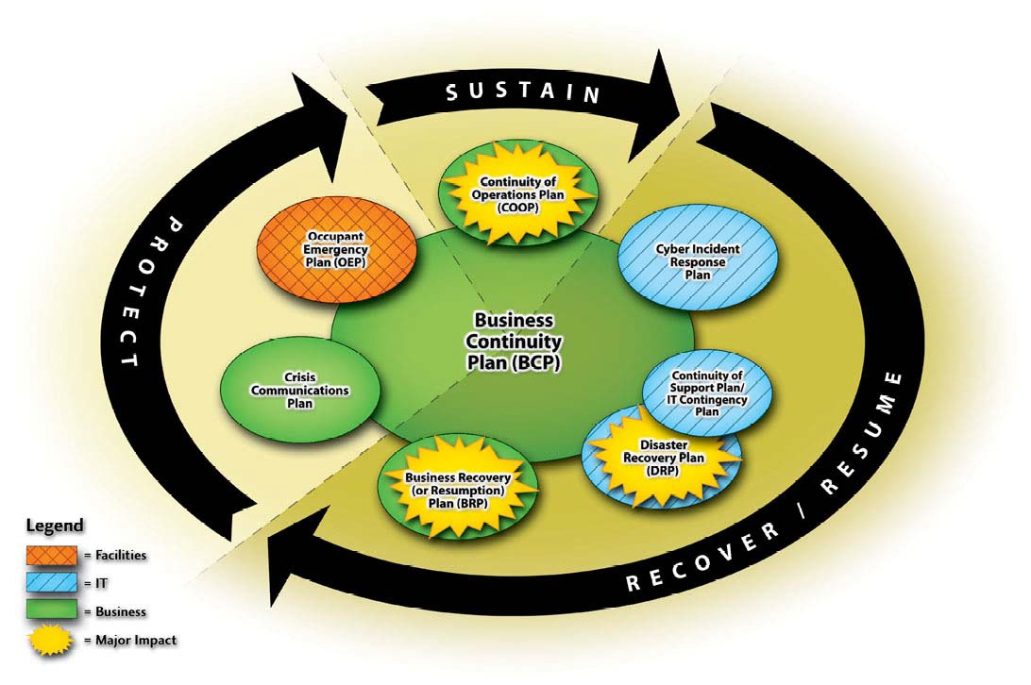
NIST 800-34
Interrelationship of the Plans

Slide 14
Roles and Responsibilities
Senior Executive Management
  Consistent support and final approval of plans
  Setting the business continuity policy
  Prioritizing critical business functions
  Allocating sufficient resources and personnel
  Providing oversight for and approving the BCP
  Directing and reviewing test results
  Ensuring maintenance of a current plan

Slide 15
Roles and Responsibilities
Senior Functional Management
Develop and document maintenance and testing strategy
Identify and prioritize mission-critical systems
Monitor progress of plan development and execution
Ensure periodic tests
Create the various teams necessary to execute the plans
Notes:
Roles and Responsibilities

Slide 16
Roles and Responsibilities
BCP Steering Committee
  Conduct the BIA
  Coordinate with department representatives
  Develop analysis group
    Plan must be developed by those who will carry it out
    Representatives from critical departments

Slide 17
BCP Teams
Teams:
  Rescue: Responsible for dealing with the immediacy of disaster—employee evacuation, “crashing” the server room, etc
  Recovery: Responsible for getting the alternate facility up and running and restoring the most critical services first.
  Salvage: Responsible for the return of operations to the original or permanent facility (reconstitution)
Notes:
Roles for executing the plans

Slide 18
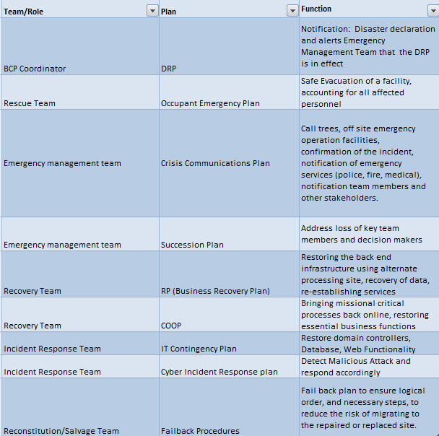
Teams, Plans, and Functions

Slide 19
Developing the Teams
Management should appoint members
Each member must understand the goals of the plan and be familiar with the department they are responsible for
Agreed upon prior to the event:
  Who will talk to the media, customers, share holders
  Who will setup alternative communication methods
  Who will setup the offsite facility
  Established agreements with off-site facilities should be in place
  Who will work on the primary facility
Notes:
Developing a Recovery Team
Once it is decided that these plans are needed, senior management must appoint specific people to perform the necessary tasks. Knowing the actual tasks of the job will help management ensure that they appoint the right people to the team. The team must then work with the management staff to develop the ultimate goals of the plan, identify the critical parts of the business that must be dealt with first during a disaster, and determine the priorities and tasks of departments. Once these directives are handed
down from management, the team now has goals, objectives, and priorities with which to shape the program. The team must focus on each threat and how that threat can affect the issues deemed most important by management. They develop procedures and tasks that must be performed in each situation and assign responsibility to different employees in charge of the different tasks. The more time that is given to this step in the process, the more likely the team will produce a very useful, effective, and complete plan.
The team may need to contact outside vendors to establish offsite solutions, redundant communication methods, data backup services, and redundant hardware. All agreements must be documented and outlined so that there is less confusion in a time of crisis. It is important that the team is made up of people who are either familiar with each and every department within the company, or is made up of representatives from each department. This is because each department is unique in its functionality and has unique risks and threats. The best plan is when all issues and threats are brought to the table and discussed; this cannot be done effectively with a few people who are only familiar with a couple of departments. It is important that representatives from each department are involved with not only the planning stages, but also the testing and implementation stages.

Slide 20

Phases of Plan:
Project Initiation
Business Impact Analysis
Recovery Strategy
Plan Design and Development
Implementation
Testing
Maintenance
Notes:
Phases of Plan:
Project Initiation
Business Impact Analysis
Recovery Strategy
Plan Design and Development
Implementation
Testing
Maintenance

Slide 21

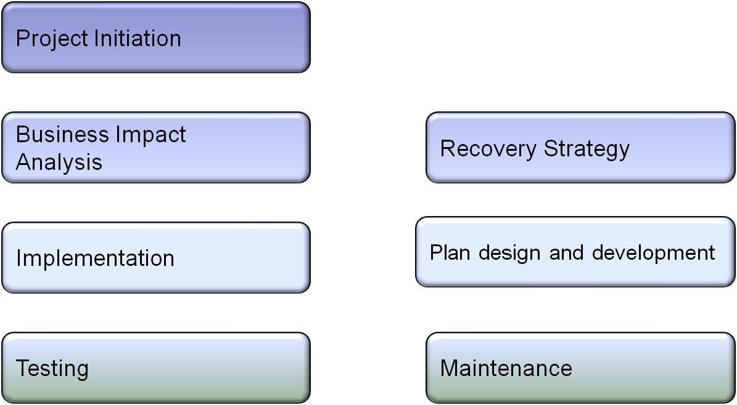
Notes:
Phases of Plan:
Project Initiation
Business Impact Analysis
Recovery Strategy
Plan Design and Development
Implementation
Testing
Maintenance

Slide 22
Phases of the Plan:
Project Initiation
Project Initiation
  Obtain senior management’s support
  Secure funding and resource allocation
  Name BCP coordinator/Project Manager
  Develop Project Charter
  Determine scope of the plan
  Select Members of the BCP Team
Notes:
In the initiation phase of Creating the Business Continuity Plan, the most important and first task is to obtain “buy-in” and support from senior managers. Executive management has two primary responsibilities—to further the business and protect the business. While BCP does nothing to grow the business, it is essential in protecting the business. Often, without a direct line to profitability, it is difficult to obtain management support. Unless this is done, however, the proper time, budget, resources won’t be available. Assuming management is on board, then funding and resources should be available. The next step of project initiation is the selection of the BCP coordinator, who will act as a project manager. This individual will be the key point of contact for ensuring that the BCP is completed and tested. The BCP coordinator is named and formally authorized in a document referred to as the Project Charter. This is a high level document issued by senior management that formally authorizes the project and the PM as well as sets preliminary goals for the project. Next, the scope of the Business Continuity Plan is agreed upon. Detailing the scope will include things like, “Is this BCP for a single branch, or for all our offices nationwide?” or “Does this BCP include plans for man-made disasters, or just natural disasters”. Finally, the BCP Team or Committee is selected. The primary job of the BCP Committee is to conduct the BIA.

Slide 23
Phases of the Plan: Business Impact Analysis
BIA (Business Impact Analysis)
  Initiated by BCP Committee
  Identifies and prioritizes all business processes
  Addresses the impact on the organization in the event of loss of a specific services or process
    Quantitative: Loss of revenue, loss of capital, loss due to liabilities, penalties and fines, etc
    Qualitative: loss of service quality, competitive advantage, market share, reputation, etc
  Establishes key metrics for use in determining appropriate counter-measures and recovery strategy
  IMPORTANCE (relevance) vs. CRITICALITY (downtime)
    The Auditing Department is certainly important, though not usually critical. THE BIA FOCUSES ON CRITICALITY
Notes:
Business Impact Analysis
A business impact analysis (BIA), is a crucial first step in disaster recovery and continuity planning. Qualitative and quantitative impact information should be gathered and then properly analyzed and interpreted. The goal is to see exactly how a business will be affected by different threats. The effects can be economical, operational, or both. This information can be gathered through standard survey tools or questionnaires given to the most knowledgeable people within the company. This will give a fuller understanding of all the possible business impacts.
This information should be gathered and documented in a clear and understandable format, which is presented to management.
It is one thing to know that if a tornado hit, it would be really bad, and it is another thing to know that if a tornado hit and affected 65 percent of the facility, the company could be at risk of losing computing capabilities for up to 72 hours, power supply up to 24 hours, and a full stop of operations for 76 hours, which equates to a loss of $125,000 each day. Management has a hard time dealing with really bad compared to real numbers.
Note
• BCP depends most upon the BIA
• Primary goals of BIA = prioritize critical functions, determine requirements for critical business functions, estimate amount of downtime company can handle
• BIA can use quantitative and quantitative tools

Slide 24
Phases of the Plan:
Business Impact Analysis
Key Metrics to Establish
  Service Level Objectives:
  RPO (Recovery Point Objective):
  MTD (Maximum Tolerable Downtime)
    RTO (Recovery Time Objective)
    WRT (Work Recovery Time)
  MTBF (Mean Time Between Failures)
  MTTR (Mean Time To Repair)
  MOR (Minimum Operating Requirements)
Notes:
****Please note: ISC2 may use different acronyms than above. Different institutions refer to the same concepts by different names. MTD can also be known as Maximum Allowable Downtime (MAD) or Maximum Tolerable Period of Disruption (MTPD)***Make sure you know the concepts, and are not “locked into” a specific acronym.

Slide 25

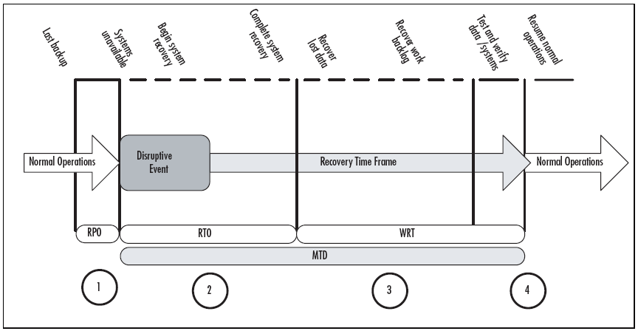
Point 1: Recovery Point Objective — The maximum sustainable data loss based on backup schedules and data needs
Point 2: Recovery Time Objective — The duration of time required to bring critical systems back online
Point 3: Work Recovery Time — The duration of time needed to recover lost data (based on RPO) and to enter data resulting from work backlogs (manual data generated during system outage that must be entered)
Points 2 and 3: Maximum Tolerable Downtime — The duration of the RTO plus the WRT.
Point 4: Test, verify, and resume normal operations
Notes:
Maximum Tolerable Downtime (MTD).This is just as it sounds — the maximum time a business can tolerate the absence or unavailability of a particular business function.) Different business functions will have different MTDs. If a business function is categorized as mission-critical, or Category 1, it will likely have the shortest MTD. There is a correlation between the criticality of a business function and its maximum downtime. The higher the criticality, the shorter the maximum tolerable downtime is likely to be. Downtime consists of two elements, the systems recovery time, also known as the RTO and the work recovery time. Therefore, MTD = RTO + WRT.
Recovery Time Objective (RTO).The time available to recover disrupted systems and resources (systems recovery time). It is typically one segment of the MTD. For example, if a critical business process has a three-day MTD, the RTO might be one day (Day 1).This is the time you will have to get systems back up and running. The remaining two days will be used for work recovery (see Work Recovery Time).
Work Recovery Time (WRT).The second segment that comprises the maximum tolerable downtime (MTD). If your MTD is three days, Day 1 might be your RTO and Days 2 to 3 might be your WRT. It takes time to get critical business functions back up and running once the systems (hardware, software, and configuration) are restored. This is an area that some planners overlook, especially from IT. If the systems are back up and running, they're all set from an IT perspective.
Recovery Point Objective (RPO).The amount or extent of data loss that can be tolerated by your critical business systems. For example, some companies perform real-time data backup, some perform hourly or daily backups, some perform weekly backups. If you perform weekly backups, someone made a decision that your company could tolerate the loss of a week's worth of data. If backups are performed on Saturday evenings and a system fails on Saturday afternoon, you've lost the entire week's worth of data. This is the recovery point objective. In this case, the RPO is one week. If this is not acceptable, your current backup processes must be reviewed and revised. The RPO is based both on current operating procedures and your estimates of what might happen in the event of a business disruption. For example, if a tornado touches down in your town and your data center is without power, you may implement your BC/DR plan. If you have an alternate computing location, you may transfer operations to that location. Your next step would be to determine the status of the data. Are you attempting to update systems using backups or were these alternate locations kept up to date? When was the last data backup performed relative to business operations? What do you need to bring systems up to date? These are the questions you'd need to answer after a business disruption. Therefore, it's important to define your RPO beforehand and ensure your recovery processes address these timelines.
During normal operations, there is usually some gap between the last backup performed and the current state of the data. In some operations, this may be minutes or hours; in most organizations it is hours or days. This timeframe is the recovery point objective. In most organizations, this is the same as the period of time between backups. We see at circle 1 that there is a gap showing the point of the last backup and the state of current data, just before the disruption occurs. That's the point at which one or more critical systems becomes unavailable and business continuity and disaster recovery planning activities are initiated. The first phase of the Maximum Tolerable Downtime (MTD) is the recovery time objective. This is the timeframe during which systems are assessed, repaired, replaced, and reconfigured. The RTO ends when systems are back online and data is recovered to the last good backup. The second phase of the MTD then begins.
This is the phase when data is recovered through automated and manual data collection processes. There are two elements of work recovery time. The first is the manual collection and entry of data lost, typically because systems went down between backups. The second phase addresses the backlog of work that may have built up while systems were down. Most companies try to recover the data up to the disruptive event to bring the systems current and then address the backlog, but your business processes may dictate a different recovery order. The key is to understand that there is a delay between the time the systems are back online and the time when normal operations can resume. During the periods indicated by circles 2 and 3, emergency workarounds and manual processes are being used. These are processes that will be developed later in your BC/DR planning process. For example, if a CRM system is down, what processes will your sales, marketing, and customer sales service teams use to interface with and manage customer service delivery? You'll define that in the planning process. Circle 4 indicates the transition from disaster recovery and business continuity back to normal operations. There may be some overlap as manual processes are turned back over to automated processes and you may choose to do it in a rolling fashion — perhaps by department or geographic region.
As you collect your impact data, you'll also need to begin determining the recovery time objectives. You may choose to create a rating system so you can quickly determine recovery time objectives. For example, you might determine that mission-critical business systems or functions should have recovery windows as follows:
Category 1: Mission-Critical — 0--12 hours
Category 2: Vital — 13--24 hours
Category 3: Important — 1--3 days
Category 4: Minor — more than 3 days
You and your team, with input from the subject matter experts, can determine the appropriate maximum tolerable downtime (MTD) requirements. For some companies, a mission-critical business function could have an MTD of a week. For others, it might be 0 to 2 hours. There is an inverse correlation between the amount of time you can tolerate an outage and the cost of setting up systems that allow you to recover in that time frame. If you can't afford much downtime, you'll clearly have to invest more in preventing downtime and in having systems in place that allow fast recovery times. If you're a small company and can afford a longer MTD, you can spend less on preventing or recovering from outages.
Let's look at an example. In a small company, you may very well be able to do without even mission-critical systems for a couple of days or a week if you really had to. It's possible that you contract with an outside IT service provider to maintain, troubleshoot, and repair your computer systems. If you want a guaranteed two-hour response time, your monthly maintenance costs will be significantly higher than if you sign up for a guaranteed next business day response. So, if you really can't afford to be without that mission-critical business function for more than about eight hours (two-hour response time, six-hour repair time), you'll have to pay more to your service company and you'll probably also have to purchase additional computer equipment to provide some redundancy to prevent extended downtime.
These costs add up and the less disruption your business can afford, the more it will cost you to prevent or mitigate those risks
****Reprinted from Chapter four of Business Continuity and Disaster Recovery Planning for IT Professionals by Susan Snedaker. Printed with permission from Syngress, a division of Elsevier. Copyright 2007. For more information about this title, please visit www.syngress.com .

Slide 26
Phases of the Plan:
Business Impact Analysis
Management should establish recovery priorities for business processes that identify:
  Essential personnel
  Technologies
  Facilities
  Communications systems
  Vital records and data

Slide 27
Results from the BIA
Results of Business Impact Analysis contain
  Identified ALL business processes and assets, not just those considered critical.
  Impact company can handle dealing with each risk
  Outage time that would be critical vs those which would not be critical
  Preventive Controls
Document and present to management for approval
Results are used to create the recovery plans
BIA
Submit to
management
DRP and BCP
derived from BIA
Notes:
Insurance can complement a disaster recovery plan, but proper balance is needed. Ensure the company is not overly insured. Cyberinsurance (covers losses due to DoS) and business interruption insurance are now both available.
**Once the BIA is completed, the next logical step is to consider preventive controls to mitigate risks associated with the processes/assets identified in the BIA. These may include
Redundant servers
Tape back-ups
Redundant links between offices
Insurance
Fire Detection and suppression
Employee

Slide 28
Phases of the Plan:
Identify Recovery Strategies
When preventive controls don’t work, recovery strategies are necessary
  Facility Recovery
  Hardware and Software Recovery
  Personnel recovery
  Data Recovery

Slide 29
Facility Recovery
Facility Recovery
  Subscription Services
  Hot, warm, cold sites
  Reciprocal Agreements
  Others
    Redundant/Mirrored site (partial or full)
    Outsourcing
    Rolling hot site
    Prefabricated building
  Offsite Facilities should be no less than 15 miles away for low to medium environments. Critical operations should have an offsite facility 50-200 miles away
Notes:
A backup site can be another location operated by the organization, or contracted via a company that specializes in disaster recovery services. In some cases, an organization will have an agreement with a second organization to operate a joint backup site. There are three types of backup sites, including cold sites, warm sites, and hot sites. The differences between the types are determined by the costs and effort required to implement each. Another term used to describe a backup site is a work area recovery site.
Choosing the type is mainly decided by an organizations cost vs. benefit strategy. Hot sites are traditionally more expensive than cold sites since much of the equipment the company needs has already been purchased and thus the operational costs are higher. However if the same organization loses a substantial amount of revenue for each day they are inactive then it may be worth the cost. Another advantage of a hot site is that it can be used for operations prior to a disaster happening.
The advantages of a cold site are simple--cost. It requires much fewer resources to operate a cold site because no equipment has been bought prior to the disaster. The downside with a cold site is the potential cost that must be incurred in order to make the cold site effective. The costs of purchasing equipment on very short notice may be higher and the disaster may make the equipment difficult to obtain.
When contracting services from a commercial provider of backup site capability organizations should take note of contractual usage provision and invocation procedures, providers may sign up more than one organization for a given site or facility, often depending on various service levels. This is a reasonable proposition as it is unlikely that all organizations using the service are likely to need it at the same time and it allows the provider to offer the service at an affordable cost. However, in a large scale incident that affects a wide area it is likely that these facilities will become over subscribed.

Slide 30
Facility Recovery Options
Alternative | Time to Occupy | Readiness | Cost
Mirrored Site | Within 24 hours | Fully redundant in every way | Highest
Hot Site | Within 24 hours | Fully configured equipment and communications links; need only load most recent data | High
Rolling Hot Site | Usually 24 hours | Similar to hot site, but supports data center operations only | High
Warm Site | Within a week | Between a hot and cold site. Partially configured equipment and does not contain any live data; some activation activity needed | Medium
Cold Site | Within 30 days | Typically contains the appropriate electrical and heating/air conditioning systems, but does not contain equipment or active communication links | Lowest
Notes:
Additional Terms regarding Facility Recovery:
Surviving site
A surviving site strategy is implemented so that while services level may drop, a function never
ceases to be performed because it operates in at least two geographically dispersed buildings that
are fully equipped and staffed.
Self-Service
A business can transfer work to another of its own locations, which has available facilities and/or
staff to manage the time sensitive workload until the interruption is over.
Internal Arrangements
Some of your internal rooms may be equipped to support business functions while staff from the
impacted site travels to another site and resumes business.
Dedicated Alternate site
Built by the company to accommodate business functions or technology recovery.
Work from home
Simply employees that will work from home to support business functions.
External Suppliers
Business recovery needs are supplied by an external provider. Could be a wide range of services
from mobile platforms, alternate site space and facilities, staff, etc…
No arrangements
For low priority business functions or applications that cannot be cost justified.
ISC2.org has offered additional input on hot sites:
Internal Hot Site
Standby site with all the necessary technology and equipment to run applications that
needs to be recovered. Data is kept in sync between primary and alternate site. This site
requires a minimal amount of time for recovery. The challenge is of course to keep the
two environments as exact copy of each others. This is not a rental place, it is your own.
External Hot Site
Equipment is in place and ready to be use. The environment must be rebuilt for recovery.
It is a rental or leased facility. Providers use generic hardware that meets most client
requirements. You may need to bring your own specialize hardware or software.

Slide 31
Facility Recovery:
Reciprocal Agreements
How long will the facility be available to the company in need?
How much assistance will the staff supply in the means of integrating the two environments and ongoing support?
How quickly can the company in need move into the facility?
What are the issues pertaining to interoperability?
How many of the resources will be available to the company in need?
How will differences and conflicts be addressed?
How does change control and configuration management take place?
Notes:
Reciprocal Agreements

Slide 32
Facility Recovery: Criteria for Alternative Facility
Is the facility closed on weekends or holidays?
Are the access controls tied in to emergency services?
Is the facility fire resistant in its construction?
What is the availability of a bonded transport service?
Are there any geographical environmental hazards?
Does the facility provide proper environmental controls?
Is there a fire detection and suppression system?
What is the vendor’s liability of stored media?
Notes:
Offsite Storage Facility Criteria

Slide 33
Hardware Recovery
Technology Recovery is dependent upon good configuration management documentation
May include
  PC’s/Servers
  Network Equipment
  Supplies
  Voice and data communications equipment
  SLA’s can play an essential role in hardware recovery—See Below
Notes:
SERVICE LEVEL AGREEMENTS (SLAs)
A common development in information technology all over the world—especially in the United States and Europe—is the use of application service providers (ASPs) to reduce the costs of application implementation and bring solutions to market faster. Organizations turn to third-party outsourcing for any number of reasons. Whether the objective is to obtain expertise or to reduce costs, application maintenance, and help desk operations, one of the most important ingredients for a successful relationship between an ASP and its customers is a strong service level agreement(SLA).
This article presents a general overview of the service level agreement, along with a list of issues you need to consider when creating your own SLA. The practical information provided here is derived from several years of experience in formulating information technology SLAs in the course of very large enterprise assignments and consulting agreements.
Contents of the SLA
A well-defined SLA records the expectations for both sides of the relationship and provides targets for accurately measuring performance against those objectives. The SLA lays down the boundaries of the project in a number of areas:
Standard(s) by which service is measured
Functions that the ASP commits to providing to the customer
Volume of work that will be accepted and delivered
Accepted criteria for responsiveness
Quality of deliverables
What should happen if something goes wrong
The SLA can end up as a very complicated document because it's meant to cover two sides, both of which are deeply interested in protecting themselves. In many cases, convoluted language in the SLA makes it complex to measure compliance. Loopholes occur due to obscure clauses related to availability, performance, and timing—all of which may be difficult to understand and measure. Therefore, preparing an SLA requires careful analysis and perhaps consultation with legal counsel.
Categories of SLA Metrics
The simplest way to approach the many possible metrics of an SLA is to group them into categories, decide which ones in a given category work best for the particular engagement, and then construct the desired metrics. The key factors can be managed through 15 major categories:
SLA document
SLA methodology/process
Process implementation
SLA measurements
Resources
Penalties
Innovation
System downtime and availability
Volume of work
Standards compliance and quality
Customer satisfaction
Sensitivity
Effectiveness
SLA implementation
Outsourcing agreement
The following sections provide some guidelines for working with the metrics in each category.
SLA Document
The SLA document is the legal binding covenant between the outsourcing company and its client. This document must describe the exact services and service levels with precise and straightforward detail about all the services and agreements.
SLA Methodology/Process
The process document must describe what method/process and procedure the outsourcing company will use to support the SLA document. Usually these processes and methodologies are left to the outsourcing company to identify, ensuring that such processes and methodologies can support the SLA agreement. However, it's recommended that the client and the outsourcing company work together during the SLA contract negotiation to eliminate any misunderstanding about the process and method of support as well as management and reporting methods.
Process Implementation
The SLA methodology/process represents the high-level solution for the problem and the best technology to be used to implement the system. The team who are involved throughout the SLA agreement, contract, and cost negotiation must also be involved throughout the process implementation, to make sure that the SLA is not broken by either party.
SLA Measurements
Some type of measurement must be used to ensure that the SLA requirements are met. For example, in help desk outsourcing, data must be collected either manually or automatically for management reporting. Automatic data collection is recommended for comprehensive and less labor-intensive SLA reporting.
Resources
The SLA should consider using external or internal resources dynamically to meet changing business conditions. The object is to use a seamless mix of services, costs, and service providers to market the solution at a competitive rate.
Penalties
Loss of business cannot be measured in dollars and cents. However, it's extremely important to determine and prioritize business functionalities from worst case to best case, measuring those functionalities in dollars and cents. The SLA also must specify penalties that would get the outsourcer's attention.
Innovation
Innovation brings services to market faster. Since much technology improves rapidly over time, service level terms and conditions should be updated periodically to match industry standards.
System Downtime and Availability
In outsourcing, guaranteeing 100% availability of services costs significantly more than guaranteeing 99% or 98%, and not every company or every application needs 100% reliability. The SLA should request service availability to meet specific business needs. To avoid confusion, create a set of definitions for performance-related terms. Indicate how service levels will be tracked, how frequently they will be reported, and how often performance will be reviewed.
Volume of Work
The volume of work sometimes is difficult to define. For example, projects that are billed on a time-and-material basis may discuss volume in terms of number of resources, while a fixed-price project usually specifies number of deliverables. This metric is an important part of the SLA, specifying the exact level of effort to be provided by the service provider within the scope of the project.
Standards Compliance and Quality
Whether your project must comply with Six Sigma, CMMI, existing coding structures, or other industry standards, quality metrics are one of the most important SLA categories, covering the conformance of a variety of documents, work products, and deliverables to those standards. Quality problems arise when the ASP fails to meet these deliverables based on the predefined metrics in the SLA document; it's important to include acceptance criteria for each deliverable to gauge whether quality is acceptable. The best solution is using credible third-party vendors to audit compliance and quality assurance.
Customer Satisfaction
Periodic surveys should be conducted by both internal and external resources to make sure that service provided by the outsourcing company is satisfactory to your customers. Survey results should be checked against the SLA to ensure that the ASP meets the targets satisfactorily.
Sensitivity
Sensitivity metrics measure the amount of time required for an outsource company to handle a request. From the client's point of view, this metric helps to determine the quality of services provided by the ASP. These metrics gauge not only satisfying end customers, but launching new products and services quickly in the market. Another measure of sensitivity is the amount of backlog.
Effectiveness
Effectiveness metrics focus on lowering costs, improving profit, and adjusting business transactions. This category helps to measure the quality of a process and its efficiency. You also need to measure rework rates for specific deliverables and processes.
SLA Implementation
A legal instrument should be created to bind both parties to the final service level agreement. While the final SLA is based on the evaluator's SLA document, it's likely that sections will be added, removed, or adjusted as dictated by negotiations.
Outsourcing Agreement
Outsourcing agreements generally can be terminated for cause upon a material breach, such as insufficient service level. Without clear language in the SLA, the parties might argue about whether a service level failure is sufficiently severe to constitute a material breach. The SLA can provide increased certainty by defining particular events that, without argument, allow termination for cause. You can set minimum service levels that allow termination.
Conclusion
Effective SLAs are extremely important to ensure effective outsourcing engagements. The metrics used to measure and manage performance to SLA commitments are the heart of a successful agreement and are a critical factor in long-term success. Lack of experience in the use and implementation of performance metrics can cause problems for many organizations as they attempt to formulate their SLA strategies and select and set the metrics needed to support those strategies. Fortunately, while reaching for perfection is difficult and costly, most companies can achieve their objectives through a carefully chosen set of collected metrics.
*Source: http://www.informit.com/articles/printerfriendly.aspx?p=414287

Slide 34
Software Recovery
BIOS Configuration information
Operating Systems
Licensing Information
Configuration Settings
Applications
Plans for what to do in the event that the operating system/applications are not longer available to be purchased

Slide 35
Personnel Recovery
Identify Essential Personnel—Entire staff is not always necessary to move into recovery operations
How to handle personnel if the offsite facility is a great distance away
Eliminate single points of failure in staffing and ensure backups are properly Trained
Don’t forget payroll!

Slide 36
Data Recovery
Data Recovery options are driven by metrics established in the BIA (MTD, RTO, RPO, etc)
Backups
Database Shadowing
Remote Journaling
Electronic Vaulting

Slide 37
Data Recovery Continued
Database Backups
  Disk-shadowing
    Mirroring technology
    Updating one or more copies of data at the same time
    Data saved to two media types for redundancy
Master Data Repository
Shadow Data Repository
Database
Notes:
Software Backups
Important data should be backed up to an on-site area and an offsite area. The on-site backup copies should be easily accessible in the case of non-disasters and provide a quick restore process so operations can return to normal. However, on-site backup copies are not enough to provide real security. The software should also be held in an offsite facility in case of actual disasters. One choice that needs to be made is where the offsite location should be located in reference to the main facility. The closer the offsite backup storage site is, the easier it is to access, but this can put the backup copies in danger if a disaster took out the company’s main facility and backup facility. It may be wiser to choose a backup facility farther away, which makes accessibility harder. Some companies choose to have more than one backup facility: one that is close and one that is farther away.
The on-site backup information should be stored in a fire-resistant safe. The procedures for backing up and restoring data should be easily accessible and comprehensible. In an emergency situation, the same guy who always does the backing up and restoring may not be around, so this information should be readily available to others. Databases require specialized backup operations, and this is why backup operations are usually integrated into the database management software as a feature. Databases can be configured to use disk-shadowing or data-mirroring technologies.

Slide 38
Data Recovery Continued
Electronic Vaulting
  Copy of modified file is sent to a remote location where an original backup is stored
  Transfers bulk backup information
  Batch process of moving data
Remote Journaling
  Moves the journal or transaction log to a remote location, not the actual files
Notes:
Notes:
Copies of essential application programs, documentation, and electronic data should be stored at a backup site
Data recovery can be very costly because of the amount of human intervention that is usually required.

Slide 39
Phases of the Plan:
Plan and Design Development
Now that all the research and planning has been done, this phase is where the actual plan is written
Should address
  Responsibility
  Authority
  Priorities
  Testing

Slide 40
Phases of the Plan:
Implementation
Plan is often created for an enterprise with individual functional managers responsible for plans specific to their departments
Copies of Plan should be kept in multiple locations
Both Electronic and paper copies should be kept
Plan should be distributed to those with a need to know. Most employees will only see a small portion of the plan

Slide 41

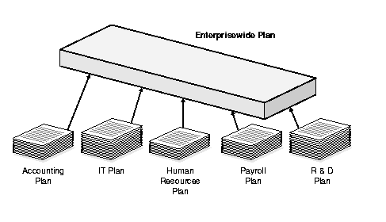
Notes:
Separate Plans
The main goal of disaster recovery and business continuity is to resume business as quickly as possible, spending the least amount of money. The main plan must be enterprise-wide. In large corporations, individual departments should have their own disaster recovery and continuity plans, because it would be hard to create one large plan that would provide enough granularity to be useful to each and every department. Each department may need to develop its own plan, which is then integrated with other departments’ plans into the overall recovery plan for the company.
The overall business interruption and resumption plan should cover all organizational elements, identify critical services and functions, provide alternatives for emergency operations, and integrate each departmental plan. This can be accomplished by in-house appointed employees, outside consultants, or a combination of both. A combination can bring many benefits to the company because the consultants are experts in this field and know the necessary steps, questions to ask, issues to look out for, and general reasonable advice, whereas the in-house employees know their company intimately and have a full understanding of how certain threats can affect operations.

Slide 42
Phases of the Plan:
Implementation
Three Phases Following a Disruption
  Notification/Activation
    Notifying recovery personnel
    Performing a damage assessment
  Recovery Phase--Failover
    Actions taken by recovery teams and personnel to restore IT operations at an alternate site or using contingency capabilities—performed by recovery team
  Reconstitution--Failback
    Outlines actions taken to return the system to normal operating conditions—performed by Salvage team
Notes:
Three Phases
Source: NIST SP 800-34

Slide 43

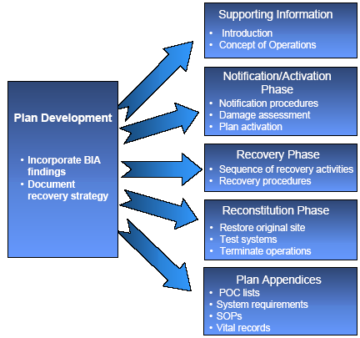

Slide 44
Phases of the Plan:
Testing
Should happen once per year, or as the result of a major change (VERY TESTABLE)
The purpose of testing is to improve the response (never to find fault or blame)
The type of testing is based upon the criticality of the organization, resources available and risk tolerance
  Testing: Happens before implementation of a plan. The goal is to ensure the accuracy and the effectiveness of the plan
  Exercises/Drills: Employees walk through step by step. Happens periodically. Main goal is to train employees
  Auditing: 3rd party observer ensures that components of a plan are being carried out and that they are effective.
Notes:
Three Phases
Source: NIST SP 800-34

Slide 45
Types of Drills
Checklist Test
  Copies of plan distributed to different departments
  Functional managers review
Structured Walk-Through (Table Top) Test
  Representatives from each department go over the plan
Simulation Test
  Going through a disaster scenario
  Continues up to the actual relocation to an offsite facility
Notes:
Types of Drills
Checklist Test
In this type of test, copies of the disaster recovery and business continuity plan are distributed to the different departments and functional areas for review. This is done so that each functional manager or team can review the plan and indicate if anything has been left out, or if some approaches should be modified or deleted. This is a method that ensures that some things have not been taken for granted or omitted. Once the departments have reviewed their copy and made suggestions, the planning team then integrates those changes into the master plan.
Structured Walk-Through Test
In this test, representatives from each department or functional area come together to go over the plan to ensure its accuracy. The group will go over the objectives of the plan, discuss the scope and assumptions of the plan, review the organization and reporting structure, and evaluate the testing, maintenance, and training requirements described. This gives the people who will be responsible for making sure that a disaster recovery happens effectively and efficiently a chance to review what has been decided upon and what is expected of them.
The group will walk through different scenarios of the plan from beginning to end to make sure nothing was left out and to raise the awareness of the recovery team members.
Simulation Test
This type of test takes a lot more planning and people. In this situation, all employees who participate in operational and support functions, or their representatives, come together to practice executing the disaster recovery plan based on a specific scenario. The scenario is used to test the reaction of each operational and support representative. Again, this is done to ensure that specific steps were not left out, to ensure that certain threats were not forgotten, and to act as a catalyst to raise the awareness of the people involved.
The drill will have only those materials that will be available in an actual disaster in order to portray a more realistic environment. The simulation test continues up to the point of actual relocation to an offsite facility and actual shipment of replacement equipment.
Parallel Test
A parallel test is done to ensure that some systems can actually perform adequately at the alternate offsite facility. The systems are moved to the alternate site and processing takes place. The results are compared with the regular processing that is done at the original site. This points out any necessary tweaking, reconfiguring, or other steps that need to take place.
Full-Interruption Test
This type of test is the most intrusive to regular operations and business productivity. The original site is actually shut down, and processing takes place at the alternate site. The recovery team fulfills their obligations in preparing the systems and environment for the alternate site. All processing will be done only on devices at the alternate offsite facility. This is a full-blown drill that takes a lot of planning and coordination, but can find a lot of holes in the plan that need to be fixed before an actual disaster hits.
Note
The first four tests are usually carried out before a full-interruption test takes place.

Slide 46
Types of Drills
Parallel Test
  Systems moved to alternate site, and processing takes place there
Full-Interruption Test
  Original site shut down
  All of processing moved to offsite facility

Slide 47
Post-incident Review
After a test or disaster has taken place:
  Focus on what happened
  What should have happened
  What should happen next
  Not who’s fault it was; this is not productive
Notes:
Post-incident Review

Slide 48
Phases of the Plan:
Maintenance
Change Management:
  Technical – hardware/software
  People
  Environment
  Laws
Large plans can take a lot of work to maintain
Does not have a direct line to profitability

Slide 49
Phases of the Plan:
Maintenance
Keeping plan in date
  Make it a part of business meetings and decisions
  Centralize responsibility for updates
  Part of job description
  Personnel evaluations
  Report regularly
  Audits
  As plans get revised, original copies should be retrieved and destroyed
Notes:
Plan Maintenance

Slide 50

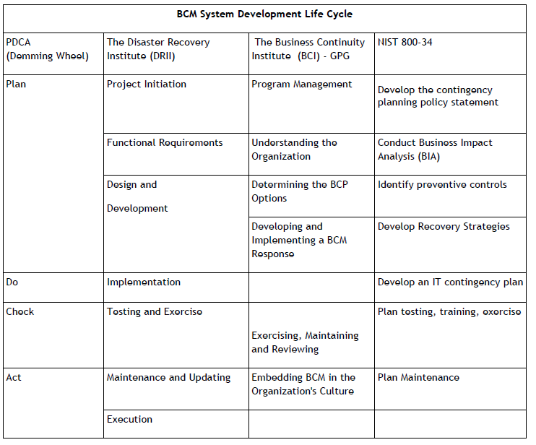

Slide 51

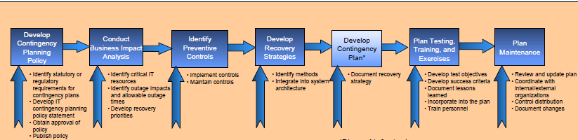

Slide 52

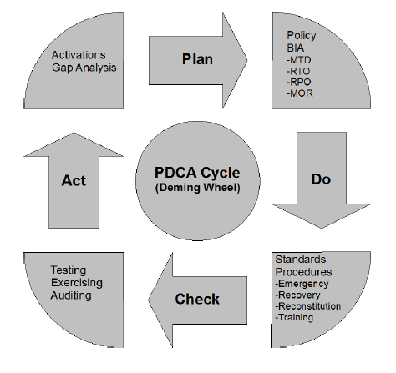

Slide 53
Agenda Review
BCP vs. DRP
Common Terms
Roles and Responsibilities
Summary BCP Sub-Plans
7 Phases of BCP
Additional Frameworks

